Slide 1
HTML5 & CSS 3 Review

Slide 2
HTML Tag & Attributes
Two-sided tag: is a tag that contains some document content. General syntax for a two-sided tag:
<element attribute1=”value1”>content</element>
A two-sided tag’s opening tag (<p>) and closing tag (</p>) should completely enclose its content
<p>Welcome to the J-Prop Shop</p>
One-sided tag: is an empty element. General syntax for a one-sided tag
<element attribute1=”value1”/>
<input type=“text” />

Slide 3
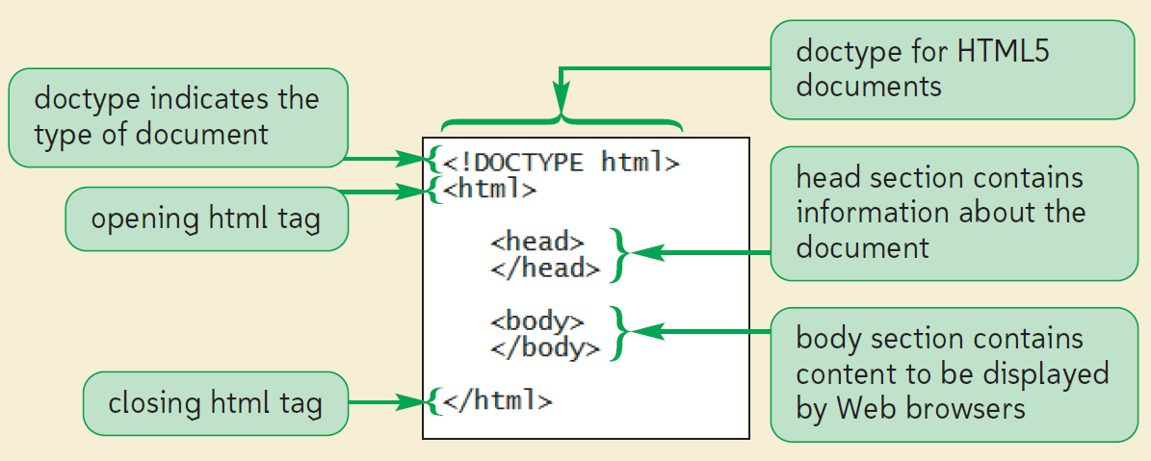
Basic Structure of HTML file

Slide 4
Defining the Page Title
<!DOCTYPE html>
<html>
<head>
<title>SaigonTech – Home page</title>
</head>
<body>
body content
</body>
</html>

Slide 5
Adding Comments
The comment tag adds notes to your HTML code
<!-- comment -->
Ex:
<!DOCTYPE html>
<html>
<head>
<!-- The sample page
Author: DanTT
Date: 16-Aug-2016 -->
<title>SaigonTech – Home page</title>
</head>
<body>…</body>
</html>

Slide 6
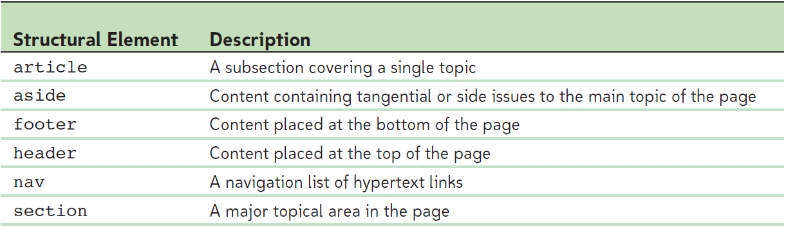
HTML5 Structural elements

Slide 7
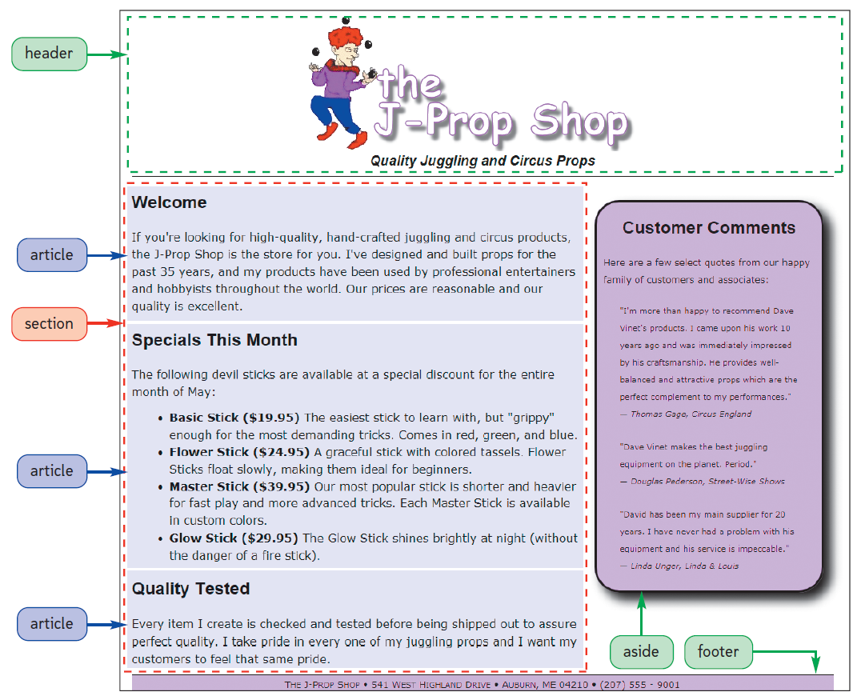

Slide 8
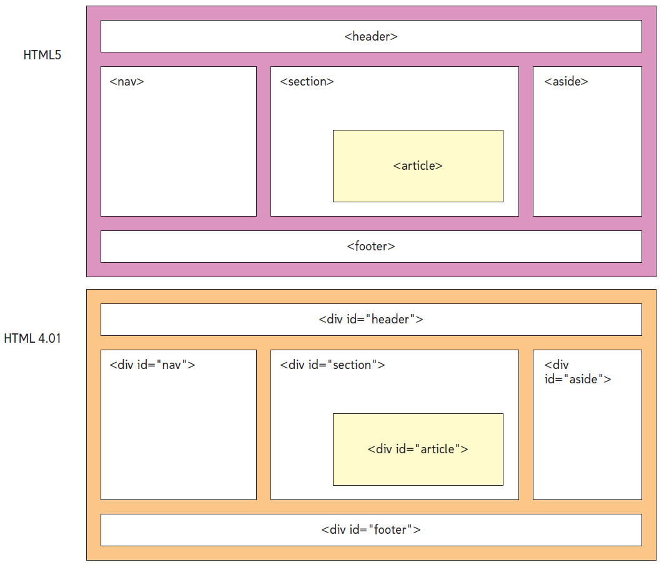

Slide 9
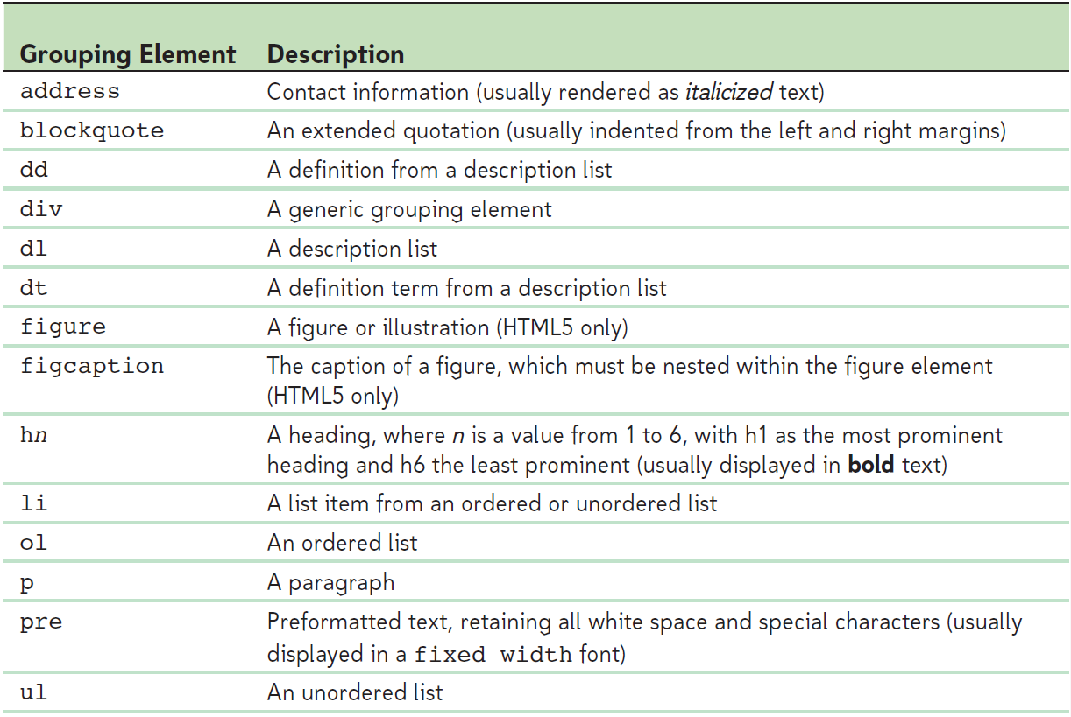
Group Elements (Block)

Slide 10
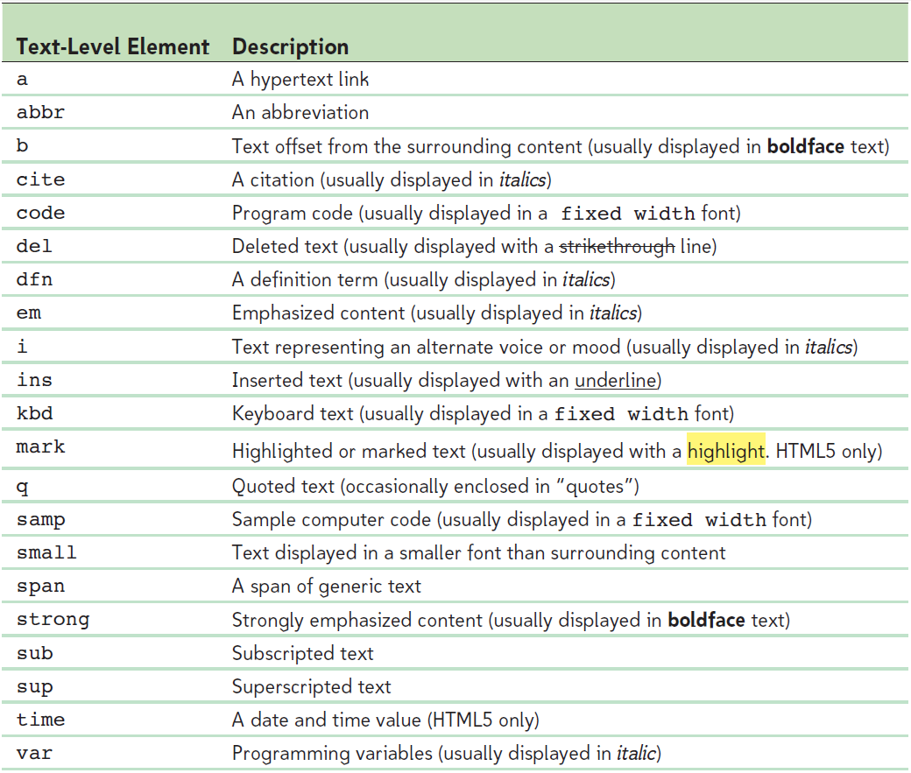
Text-Level Element (Inline)

Slide 11
Other Tags
<hr />
<br />
<img />

Slide 12
Character Sets and Special Characters
Character Encoding
&#code;
Ex: &#169; → ©
Character Entity References
&char;
Ex: &copy; → ©

Slide 13
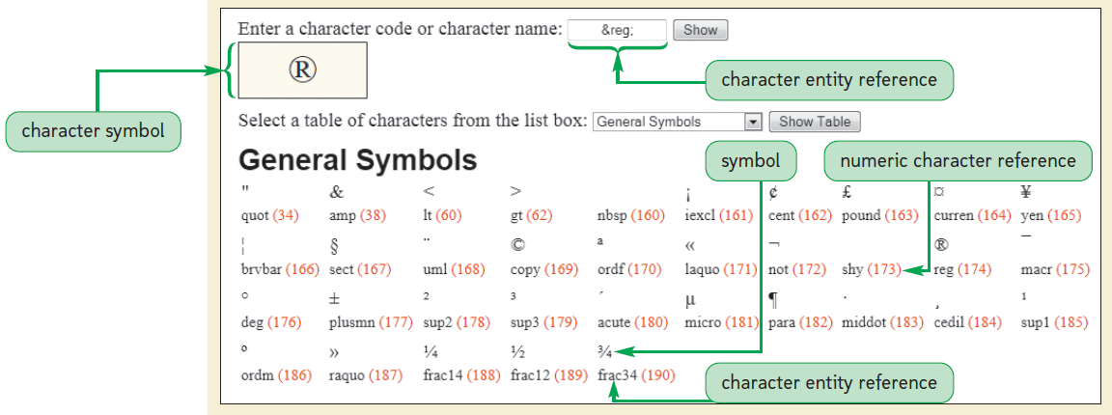
HTML characters

Slide 14
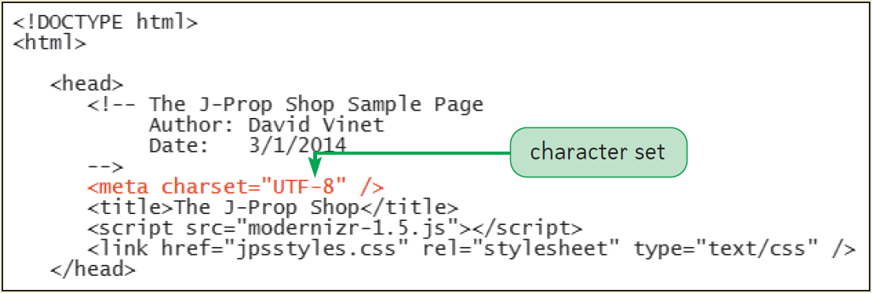
Specifying the Character Set
To render a numeric character reference correctly, a browser must apply the correct character set to a Web page
<meta charset=”character_set” />

Slide 15
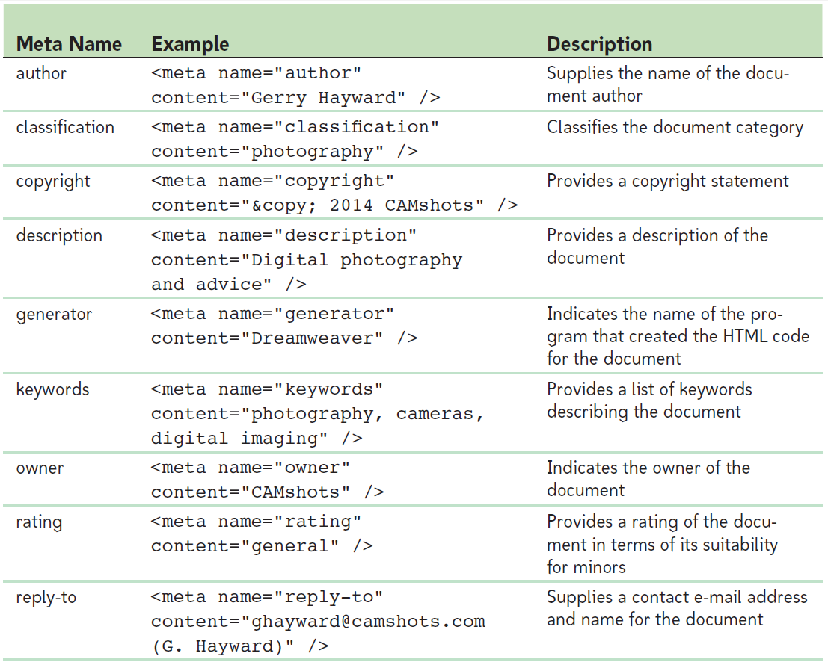
Working with Metadata

Slide 16
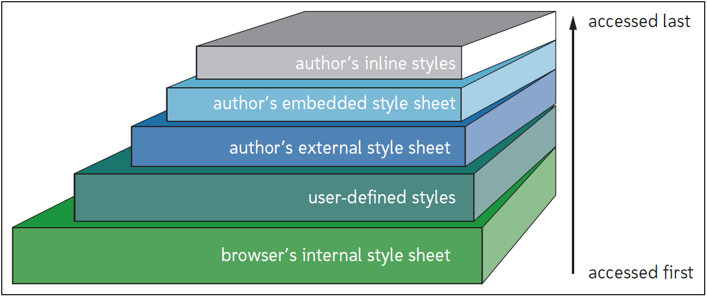
CSS

Slide 17
CSS Factors
Sharp(#): for Id
Dot(.): class
HTML element

Slide 18
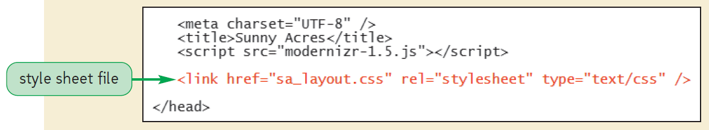
External Style Sheets
<link href=”url” rel=”stylesheet” type=”text/css” media=“device” />
To import a stylesheet use
@import url(url);
Ex: @import url(company.css);
@import url(support.css);

Slide 19
Embedded Style Sheets
Place <style> in <head> tag
<style type=”text/css”>
styles
</style>
Ex:
<style type=”text/css”>
h1 {
color: red;
text-align: center;
}
</style>

Slide 20
Inline Styles
<element style=”property1: value1; ”> … </element>
Ex:
<h1 style=”color: green; text-align: center;”>
Sunny Acres
</h1>

Slide 21
Style Cascade
Style Precedence and Specificity
body {color: black;}
header {color: red;}
Style Inheritance
#content { color: red; }
#content h1 { text-align: center; font-style: italic;}
Defining Important Styles
property: value !important;
Ex: h1 {color: orange !important;}

Slide 22
Style Comments
/*
Sunny Acres
Style Sheet
*/

Slide 23
References
CSS Tutorial
http://www.w3schools.com/css/default.asp
CSS Selectors
http://www.w3schools.com/cssref/css_selectors.asp
CSS Properties
http://www.w3schools.com/cssref/default.asp

